Slide 1
Classical Methods for Object Recognition
Rob Fergus (NYU)

Slide 2

Classical Methods
Bag of words approaches
Parts and structure approaches
Discriminative methods
Condensed version
of sections from
2007 edition of
tutorial

Slide 3
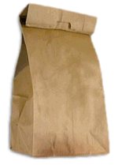
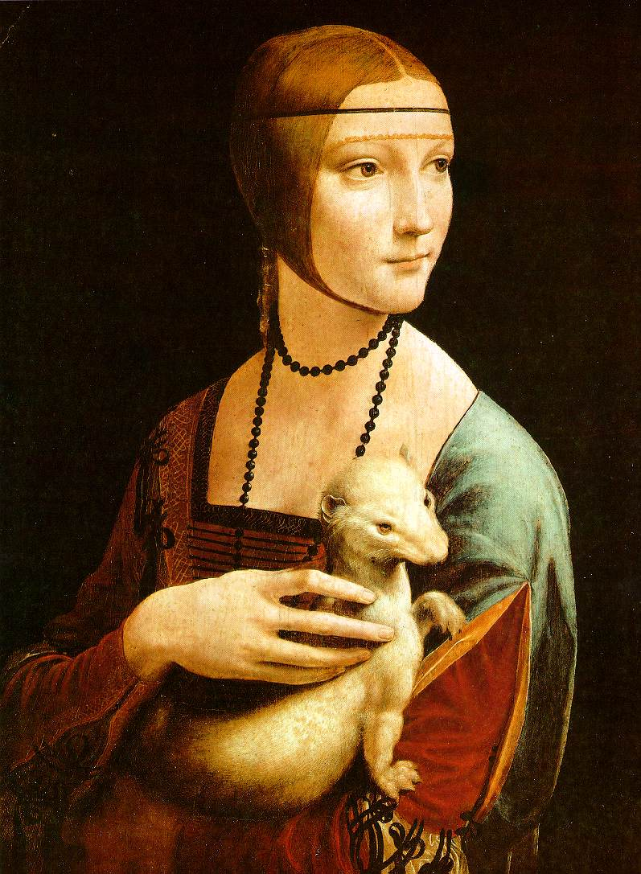
Bag of Words
Models

Slide 4
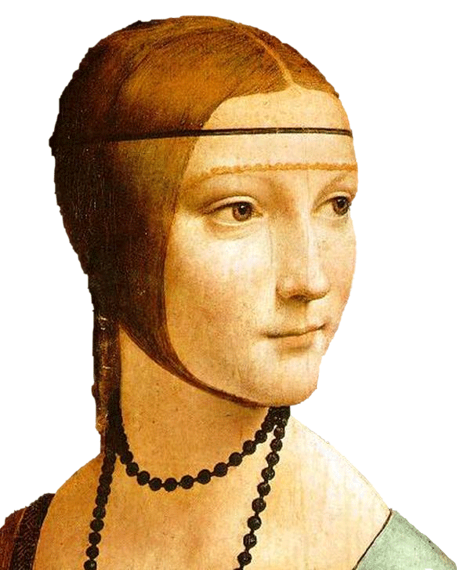
Object
Bag of ‘words’

Slide 5
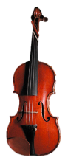
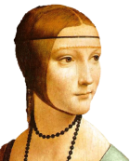
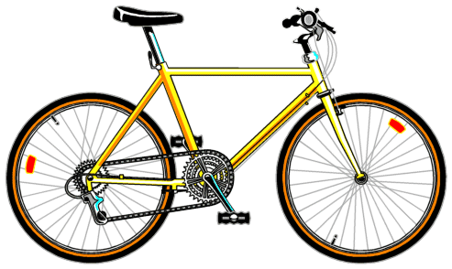
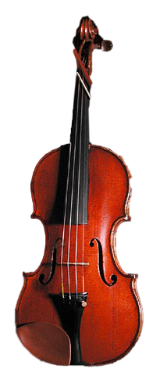
Bag of Words
Independent features
Histogram representation

Slide 6
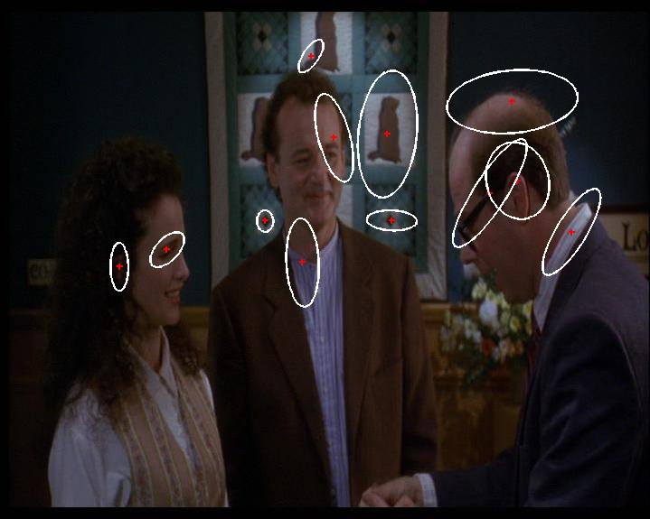
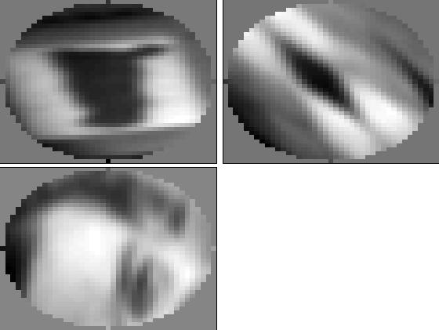
1.Feature detection and representation
Compute descriptor
e.g. SIFT [Lowe’99]
Normalize patch
Detect patches
[Mikojaczyk and Schmid ’02]
[Mata, Chum, Urban & Pajdla, ’02]
[Sivic & Zisserman, ’03]
Local interest operator
or
Regular grid
Slide credit: Josef Sivic

Slide 7
1.Feature detection and representation
…

Slide 8
2. Codewords dictionary formation
…
128-D SIFT space

Slide 9
2. Codewords dictionary formation
Codewords
…
+
+
+
Vector quantization
128-D SIFT space
Slide credit: Josef Sivic

Slide 10
Image patch examples of codewords
Sivic et al. 2005

Slide 11
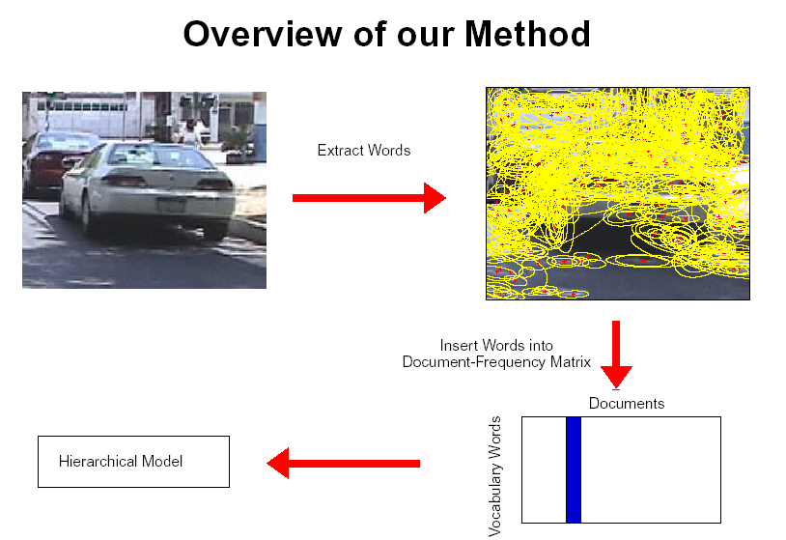
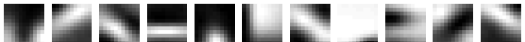
Image representation
Histogram of features assigned to each cluster
frequency
…..
codewords

Slide 12
Uses of BoW representation
Treat as feature vector for standard classifier
e.g SVM
Cluster BoW vectors over image collection
Discover visual themes
Hierarchical models
Decompose scene/object
Scene

Slide 13
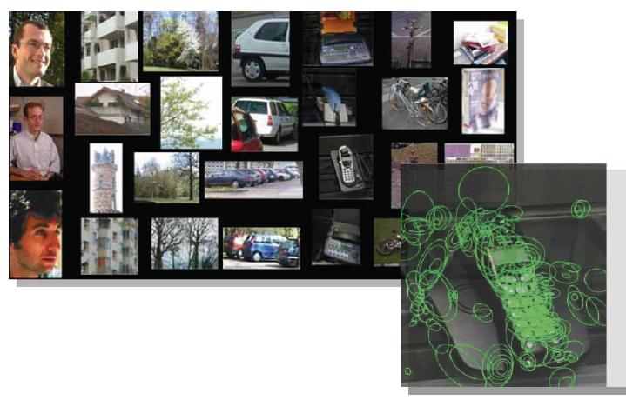
BoW as input to classifier
SVM for object classification
Csurka, Bray, Dance & Fan, 2004
Naïve Bayes
See 2007 edition of this course

Slide 14
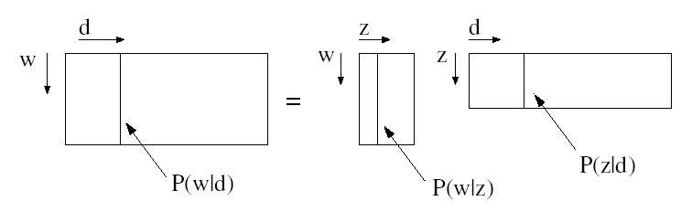
Clustering BoW vectors
Use models from text document literature
Probabilistic latent semantic analysis (pLSA)
Latent Dirichlet allocation (LDA)
See 2007 edition for explanation/code
d = image, w = visual word, z = topic (cluster)

Slide 15
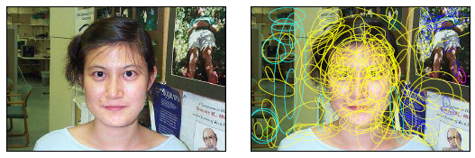
Clustering BoW vectors
Scene classification (supervised)
Vogel & Schiele, 2004
Fei-Fei & Perona, 2005
Bosch, Zisserman & Munoz, 2006
Object discovery (unsupervised)
Each cluster corresponds to visual theme
Sivic, Russell, Efros, Freeman & Zisserman, 2005

Slide 16
Related work
Early “bag of words” models: mostly texture recognition
Cula & Dana, 2001; Leung & Malik 2001; Mori, Belongie & Malik, 2001; Schmid 2001; Varma & Zisserman, 2002, 2003; Lazebnik, Schmid & Ponce, 2003
Hierarchical Bayesian models for documents (pLSA, LDA, etc.)
Hoffman 1999; Blei, Ng & Jordan, 2004; Teh, Jordan, Beal & Blei, 2004
Object categorization
Csurka, Bray, Dance & Fan, 2004; Sivic, Russell, Efros, Freeman & Zisserman, 2005; Sudderth, Torralba, Freeman & Willsky, 2005;
Natural scene categorization
Vogel & Schiele, 2004; Fei-Fei & Perona, 2005; Bosch, Zisserman & Munoz, 2006

Slide 17




What about spatial info?
?

Slide 18
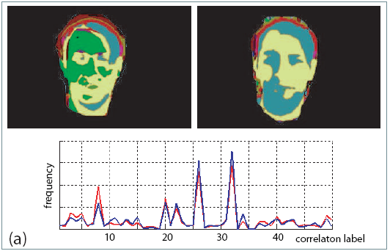
Adding spatial info. to BoW
Feature level
Spatial influence through correlogram features: Savarese, Winn and Criminisi, CVPR 2006

Slide 19
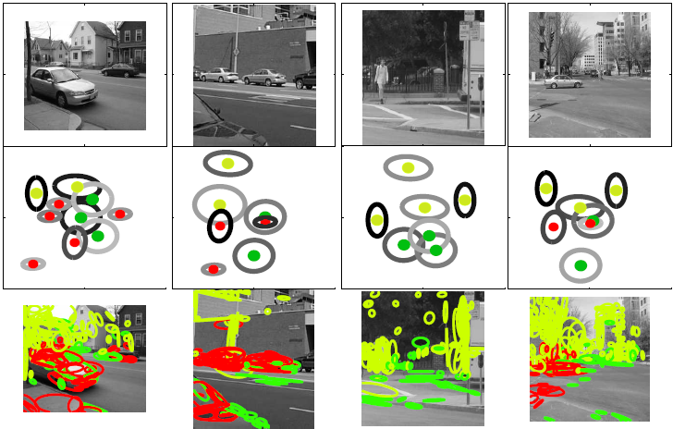
Adding spatial info. to BoW
Feature level
Generative models
Sudderth, Torralba, Freeman & Willsky, 2005, 2006
Hierarchical model of scene/objects/parts

Slide 20
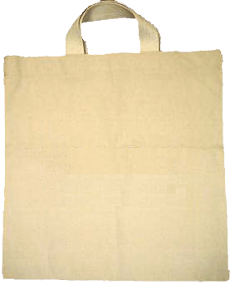
Adding spatial info. to BoW
Feature level
Generative models
Sudderth, Torralba, Freeman & Willsky, 2005, 2006
Niebles & Fei-Fei, CVPR 2007
P₁
P₂
P₃
P₄
w
Image
Bg

Slide 21
Adding spatial info. to BoW
Feature level
Generative models
Discriminative methods
Lazebnik, Schmid & Ponce, 2006

Slide 22
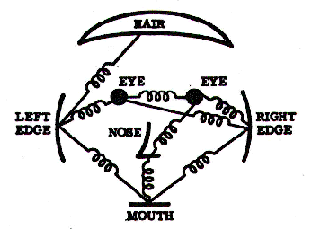
Part-based Models

Slide 23
Problem with bag-of-words
All have equal probability for bag-of-words methods
Location information is important
BoW + location still doesn’t give correspondence
Notes:
Motivation slide. Clearly location has to help, but bag-of-words doesn’t have it…

Slide 24
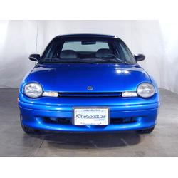
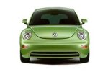
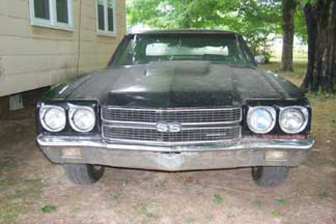
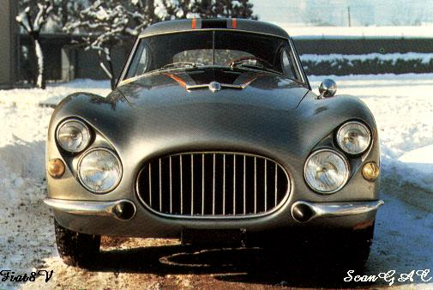
Model: Parts and Structure
Notes:
Globally different, but have portions in common

Slide 25
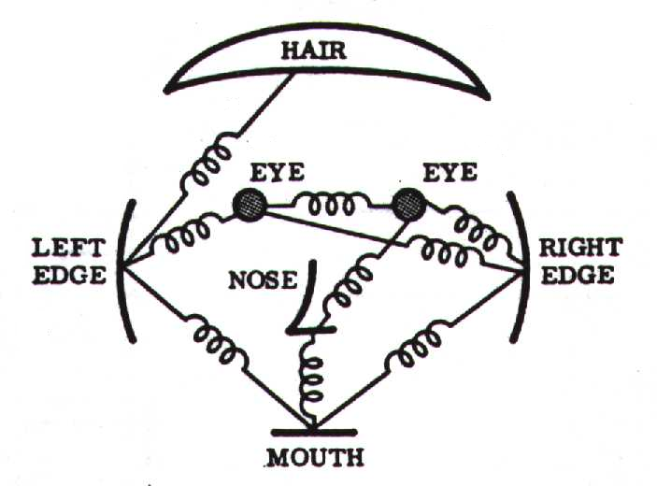
Representation
Object as set of parts
Generative representation
Model:
Relative locations between parts
Appearance of part
Issues:
How to model location
How to represent appearance
How to handle occlusion/clutter
Figure from [Fischler & Elschlager 73]

Slide 26
History of Parts and Structure approaches
Fischler & Elschlager 1973
Yuille ‘91
Brunelli & Poggio ‘93
Lades, v.d. Malsburg et al. ‘93
Cootes, Lanitis, Taylor et al. ‘95
Amit & Geman ‘95, ‘99
Perona et al. ‘95, ‘96, ’98, ’00, ’03, ‘04, ‘05
Felzenszwalb & Huttenlocher ’00, ’04
Crandall & Huttenlocher ’05, ’06
Leibe & Schiele ’03, ’04
Many papers since 2000

Slide 27
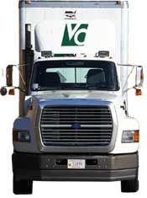
Sparse representation
+ Computationally tractable (10⁵ pixels → 10¹ -- 10² parts)
+ Generative representation of class
+ Avoid modeling global variability
+ Success in specific object recognition
- Throw away most image information
- Parts need to be distinctive to separate from other classes

Slide 28
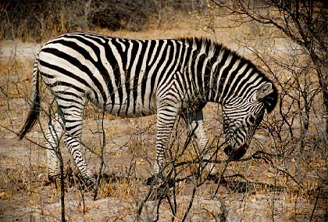
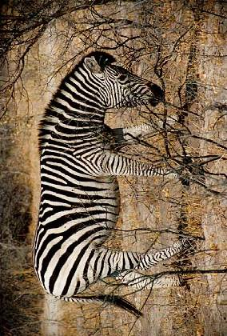
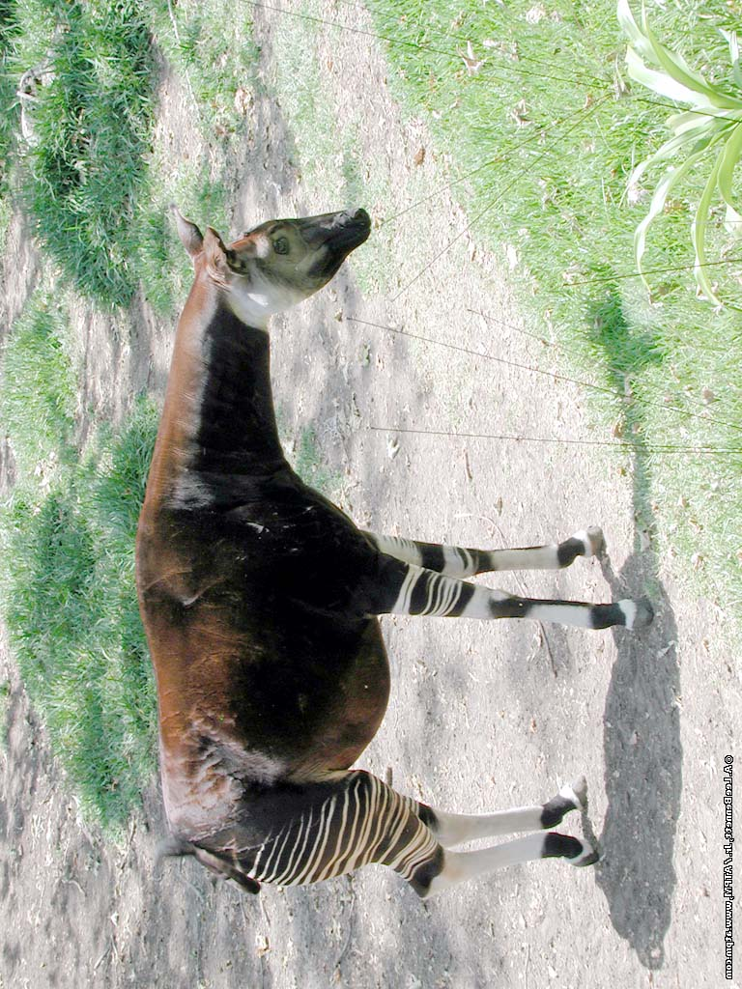
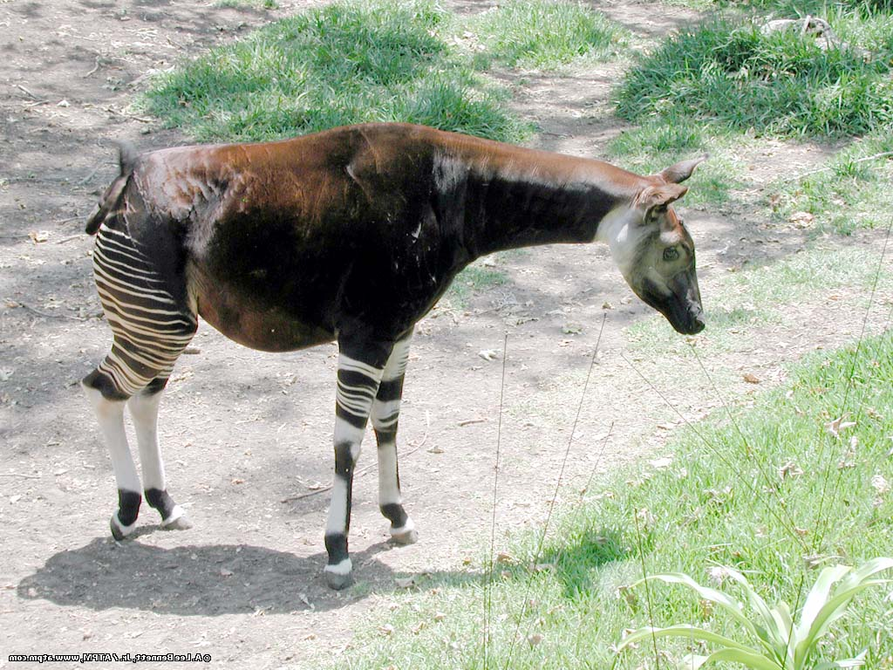
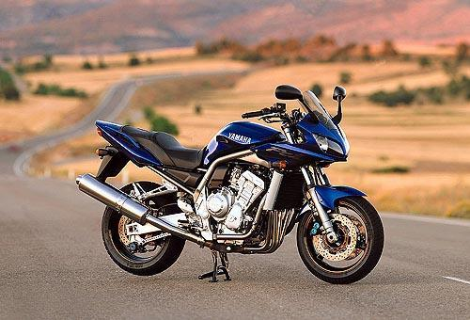
The correspondence problem
Model with P parts
Image with N possible assignments for each part
Consider mapping to be 1-1
N^{P} combinations!!!
Notes:
Key problem with approach & motivates design choices. Assume for the moment that we have a set of regions.

Slide 29
from Sparse Flexible Models of Local Features Gustavo Carneiro and David Lowe, ECCV 2006
Different connectivity structures
Fergus et al. ’03
Fei-Fei et al. ‘03
Crandall et al. ‘05
Fergus et al. ’05
Crandall et al. ‘05
Felzenszwalb & Huttenlocher ‘00
O(N²)
O(N⁶)
O(N²)
O(N³)
Csurka ’04
Vasconcelos ‘00
Bouchard & Triggs ‘05
Carneiro & Lowe ‘06

Slide 30
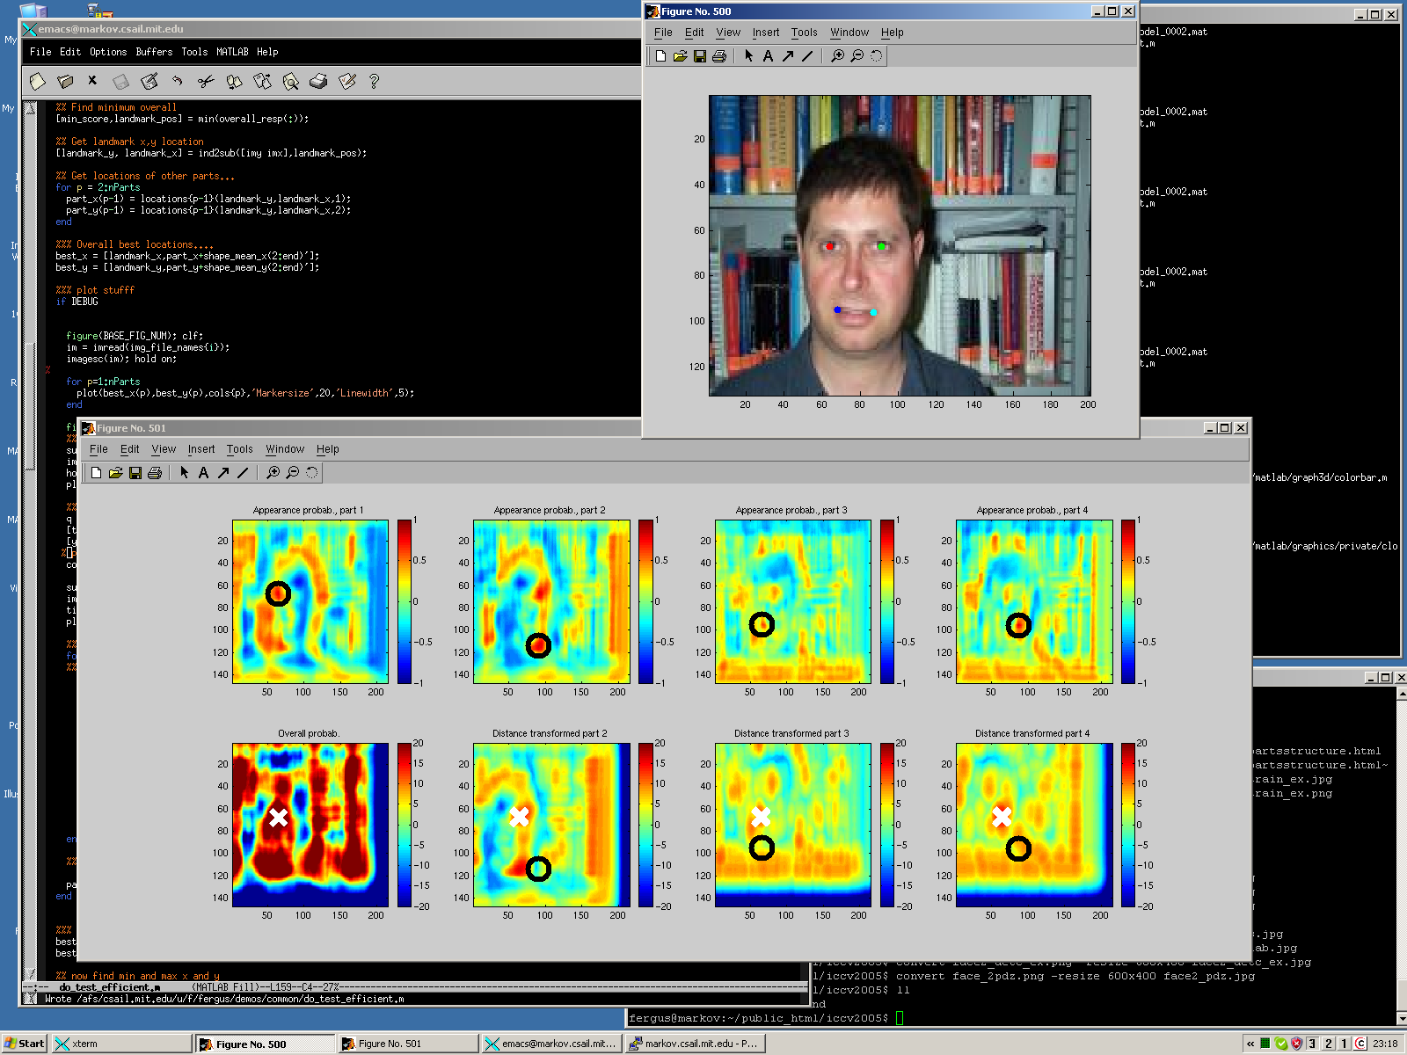

Efficient methods
Distance transforms
Felzenszwalb and Huttenlocher ‘00 and ‘05
O(N2P) → O(NP) for tree structured models
Removes need for region detectors

Slide 31
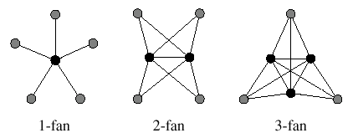
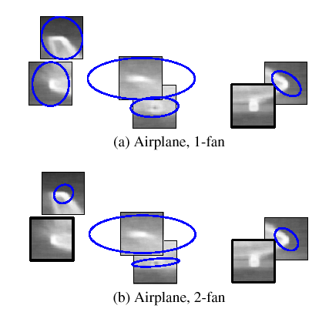
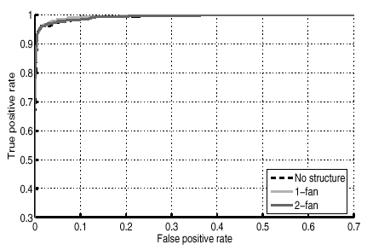
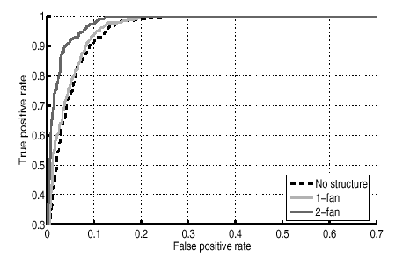
How much does shape help?
Crandall, Felzenszwalb, Huttenlocher CVPR’05
Shape variance increases with increasing model complexity
Do get some benefit from shape

Slide 32
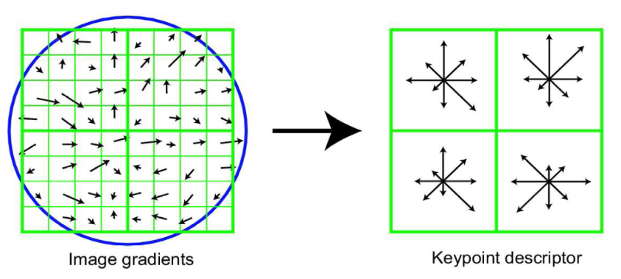
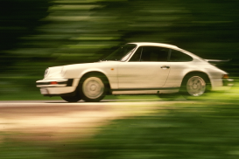
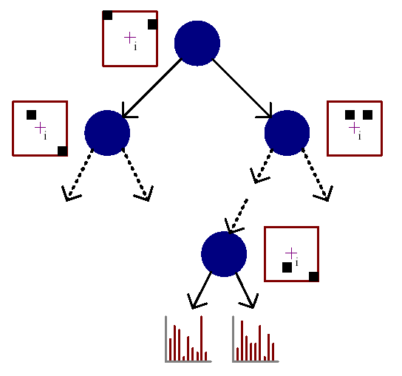
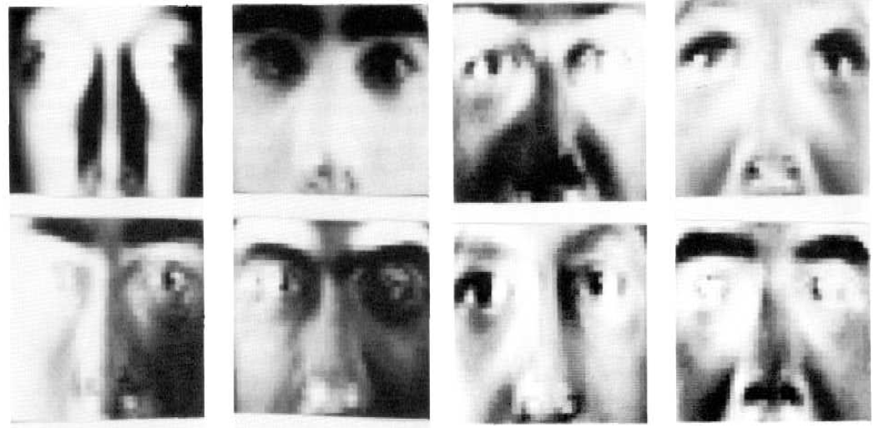
Appearance representation
SIFT
Decision trees
[Lepetit and Fua CVPR 2005]
PCA
Figure from Winn & Shotton, CVPR ‘06

Slide 33
Learn Appearance
Generative models of appearance
Can learn with little supervision
E.g. Fergus et al’ 03
Discriminative training of part appearance model
SVM part detectors
Felzenszwalb, Mcallester, Ramanan, CVPR 2008
Much better performance

Slide 34
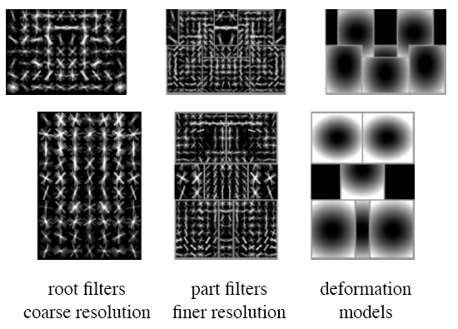
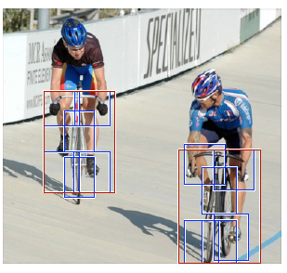
Felzenszwalb, Mcallester, Ramanan, CVPR 2008
2-scale model
Whole object
Parts
HOG representation + SVM training to obtain robust part detectors
Distance transforms allow examination of every location in the image

Slide 35
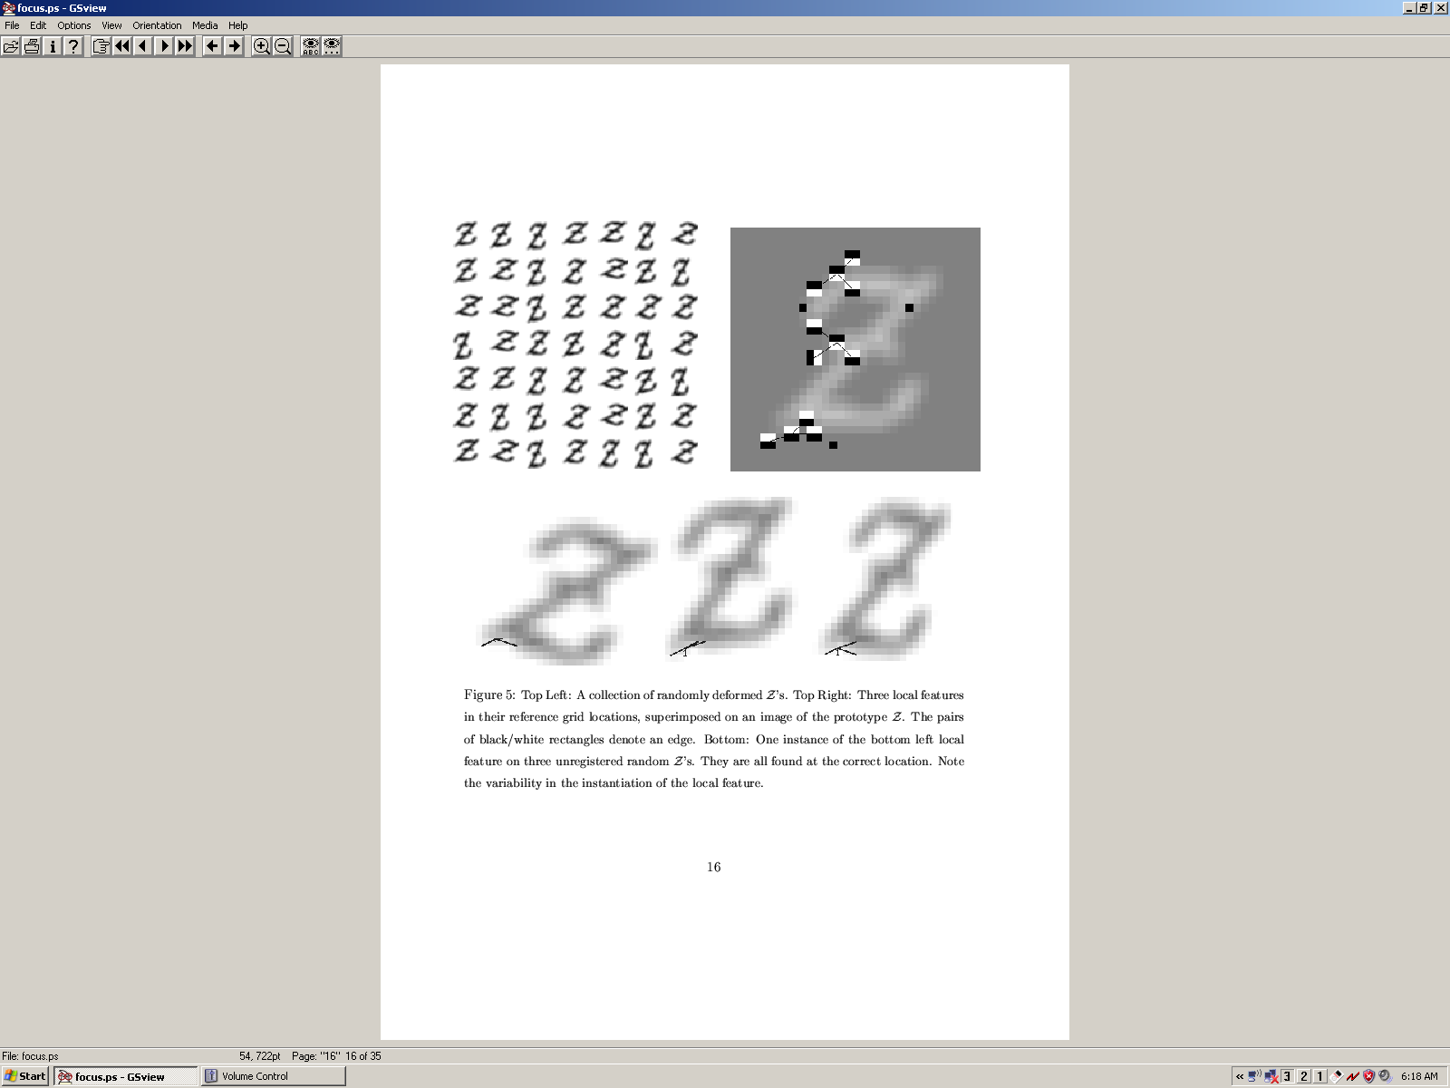
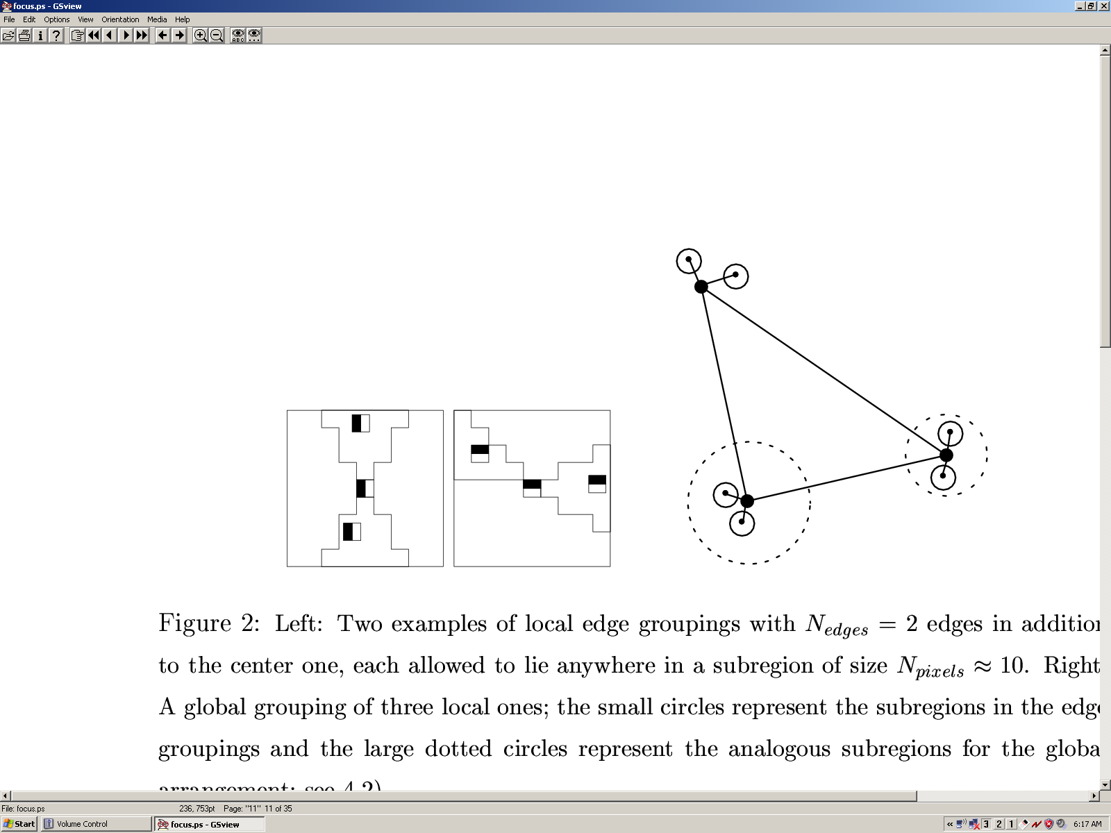
Hierarchical Representations
Pixels → Pixel groupings → Parts → Object
Multi-scale approach increases number of low-level features
Amit and Geman ’98
Ullman et al.
Bouchard & Triggs ’05
Zhu and Mumford
Jin & Geman ‘06
Zhu & Yuille ’07
Fidler & Leonardis ‘07
Images from [Amit98]

Slide 36
Stochastic Grammar of Images S.C. Zhu et al. and D. Mumford

Slide 37

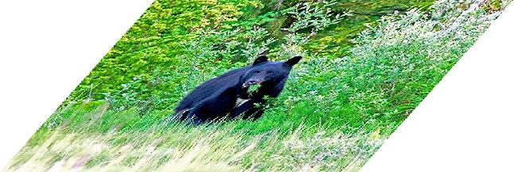
Context and Hierarchy in a Probabilistic Image Model Jin & Geman (2006)
e.g. animals, trees, rocks
e.g. contours, intermediate objects
e.g. linelets, curvelets, T-junctions
e.g. discontinuities, gradient
animal head instantiated by tiger head
animal head instantiated by bear head

Slide 38
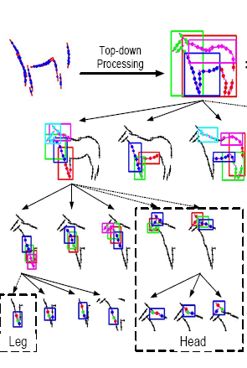
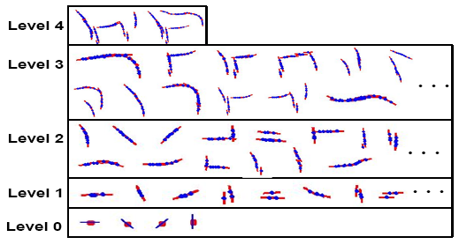
A Hierarchical Compositional System for Rapid Object Detection Long Zhu, Alan L. Yuille, 2007.
Able to learn #parts at each level

Slide 39
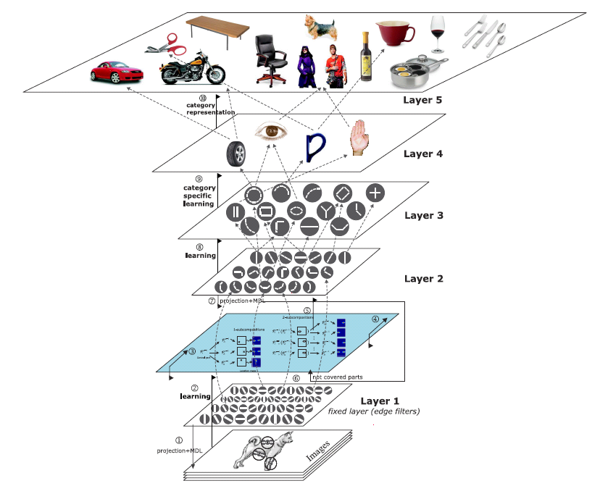
Learning a Compositional Hierarchy of Object Structure
Fidler & Leonardis, CVPR’07; Fidler, Boben & Leonardis, CVPR 2008
Parts model
The architecture
Learned parts

Slide 40
Parts and Structure models Summary
Explicit notion of correspondence between image and model
Efficient methods for large # parts and # positions in image
With powerful part detectors, can get state-of-the-art performance
Hierarchical models allow for more parts

Slide 41
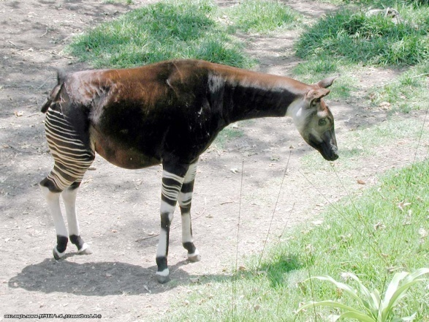
Classifier-based methods

Slide 42
Classifier based methods
Object detection and recognition is formulated as a classification problem.
The image is partitioned into a set of overlapping windows
… and a decision is taken at each window about if it contains a target object or not.
Decision boundary
Background
Where are the screens?
Bag of image patches
Computer screen
In some feature space

Slide 43
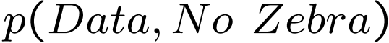
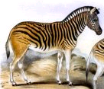
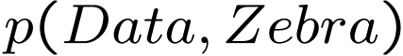





Discriminative vs. generative
Generative model
(The artist)
0.1
0.05
0
0
10
20
30
40
50
60
70
x = data
Discriminative model
(The lousy
painter)
1
0.5
0
0
10
20
30
40
50
60
70
x = data
Classification function
1
-1
0
10
20
30
40
50
60
70
80
x = data

Slide 44


Formulation
Formulation: binary classification
…
x₁
x₂
x₃
…
x_{N}
x_{N+1}
x_{N+2}
…
x_{N+M}
Features x =
Labels
y =
-1
+1
-1
-1
?
?
?
Training data: each image patch is labeled
as containing the object or background
Test data
Classification function
Where belongs to some family of functions
Minimize misclassification error
(Not that simple: we need some guarantees that there will be generalization)

Slide 45

Face detection
The representation and matching of pictorial structures Fischler, Elschlager (1973).
Face recognition using eigenfaces M. Turk and A. Pentland (1991).
Human Face Detection in Visual Scenes - Rowley, Baluja, Kanade (1995)
Graded Learning for Object Detection - Fleuret, Geman (1999)
Robust Real-time Object Detection - Viola, Jones (2001)
Feature Reduction and Hierarchy of Classifiers for Fast Object Detection in Video Images - Heisele, Serre, Mukherjee, Poggio (2001)
….

Slide 46


Features: Haar filters
Haar filters and integral image
Viola and Jones, ICCV 2001
Haar wavelets
Papageorgiou & Poggio (2000)

Slide 47



Features: Edges and chamfer distance
Gavrila, Philomin, ICCV 1999

Slide 48
Features: Edge fragments
Opelt, Pinz, Zisserman, ECCV 2006
Weak detector = k edge fragments and threshold. Chamfer distance uses 8 orientation planes

Slide 49


Features: Histograms of oriented gradients
Shape context
Belongie, Malik, Puzicha, NIPS 2000
SIFT, D. Lowe, ICCV 1999
Dalal & Trigs, 2006

Slide 50








Classifier: Nearest Neighbor
Shakhnarovich, Viola, Darrell, 2003
10⁶ examples
Berg, Berg and Malik, 2005

Slide 51
Classifier: Neural Networks
Fukushima’s Neocognitron, 1980
Rowley, Baluja, Kanade 1998
LeCun, Bottou, Bengio, Haffner 1998
Serre et al. 2005
Riesenhuber, M. and Poggio, T. 1999
LeNet convolutional architecture (LeCun 1998)

Slide 52


Classifier: Support Vector Machine
Guyon, Vapnik
Heisele, Serre, Poggio, 2001
……..
Dalal & Triggs , CVPR 2005
HOG – Histogram of Oriented gradients
Learn weighting of descriptor with linear SVM
Image
HOG
descriptor
HOG descriptor weighted by
+ve SVM -ve SVM
weights

Slide 53






Classifier: Boosting
Viola & Jones 2001
Haar features via Integral Image
Cascade
Real-time performance
…….
Torralba et al., 2004
Part-based Boosting
Each weak classifier is a part
Part location modeled by offset mask

Slide 54
Summary of classifier-based methods
Many techniques for training discriminative models are used
Many not mentioned here
Conditional random fields
Kernels for object recognition
Learning object similarities
.....

Slide 56
Dalal & Triggs HOG detector
HOG – Histogram of Oriented gradients
Careful selection of spatial bin size/# orientation bins/normalization
Learn weighting of descriptor with learn SVM
Image
HOG
descriptor
HOG descriptor weighted by
+ve SVM -ve SVM
weights

